Slide 1

Ashton Gate Primary
Reception 2025 Parent Curriculum meeting

Slide 2
Prime areas
- Communication and Language
- Personal, Social and Emotional Development (self- regulation)
- Physical Development

Slide 3
How we learn...
- Characteristics of Effective Learning
- EllI animals/ Ashton Gater
- Growth Mindset – the power of 'yet'
Equality & Inclusion
- Independence

Slide 4
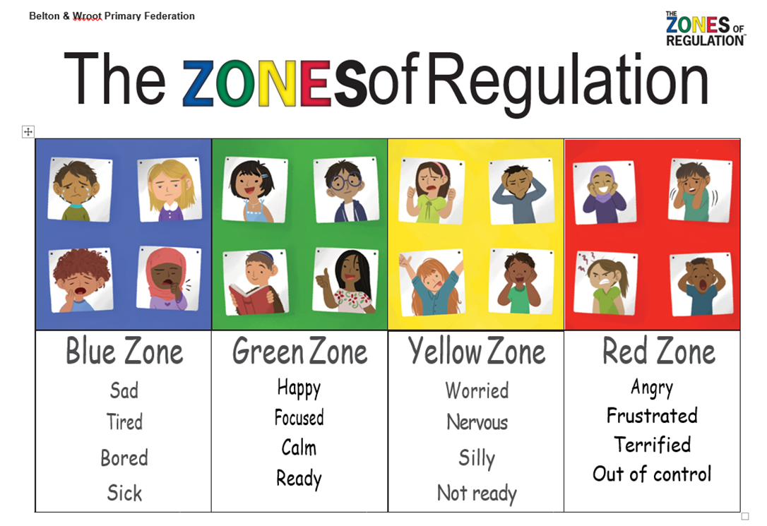
Zones of Regulation

Slide 5


Reading
How we teach reading ….
We use Little Wandle Letters and Sounds Revised scheme.
3 main aims we have for our children in reading
To develop decoding skills and fluency.
To be able to understand and talk about what they have read.
Enjoy reading for pleasure

Slide 6

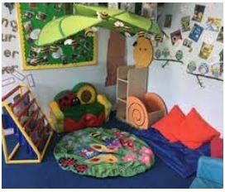
Our focus in Reception
Decoding – In Reception we start at the very beginning with teaching the children the skills they need to decode and read words.
Daily phonics sessions
Daily keep up sessions for those who need it.
Blending blasts once a day.
Twice weekly group reading sessions with Teacher or LSA
Book Corners in classrooms and outside to encourage reading for pleasure
Library visits once a week.
Daily Book Time

Slide 7

Reading at home
Your child will be coming home with 3 books
An eBook that mirrors the book they have been reading in reading groups that week - comprehension focus, should be able to read mainly independently.
A decodable reading book, matched to the sounds they know – focus on decoding.
A reading for pleasure book from the library to share.

Slide 8
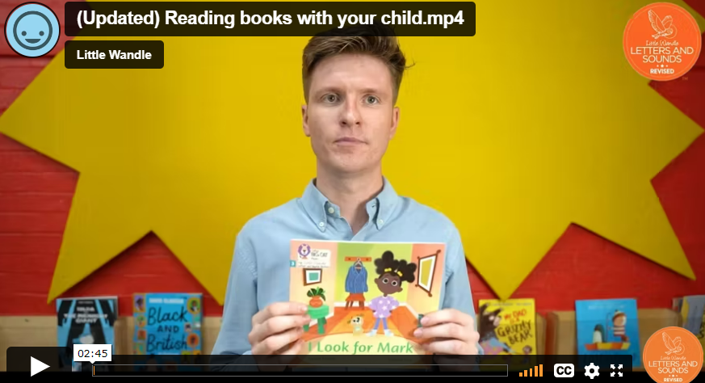
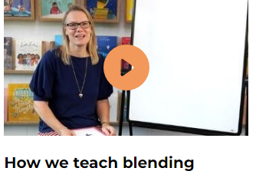
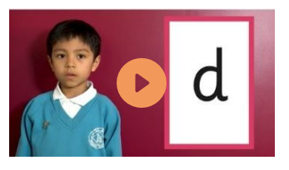
https://www.littlewandlelettersandsounds.org.uk/resources/for-parents/
Little Wandle support for parents.

Slide 9
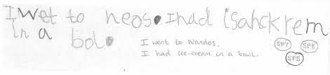
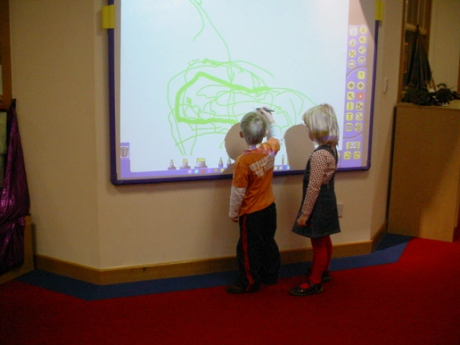
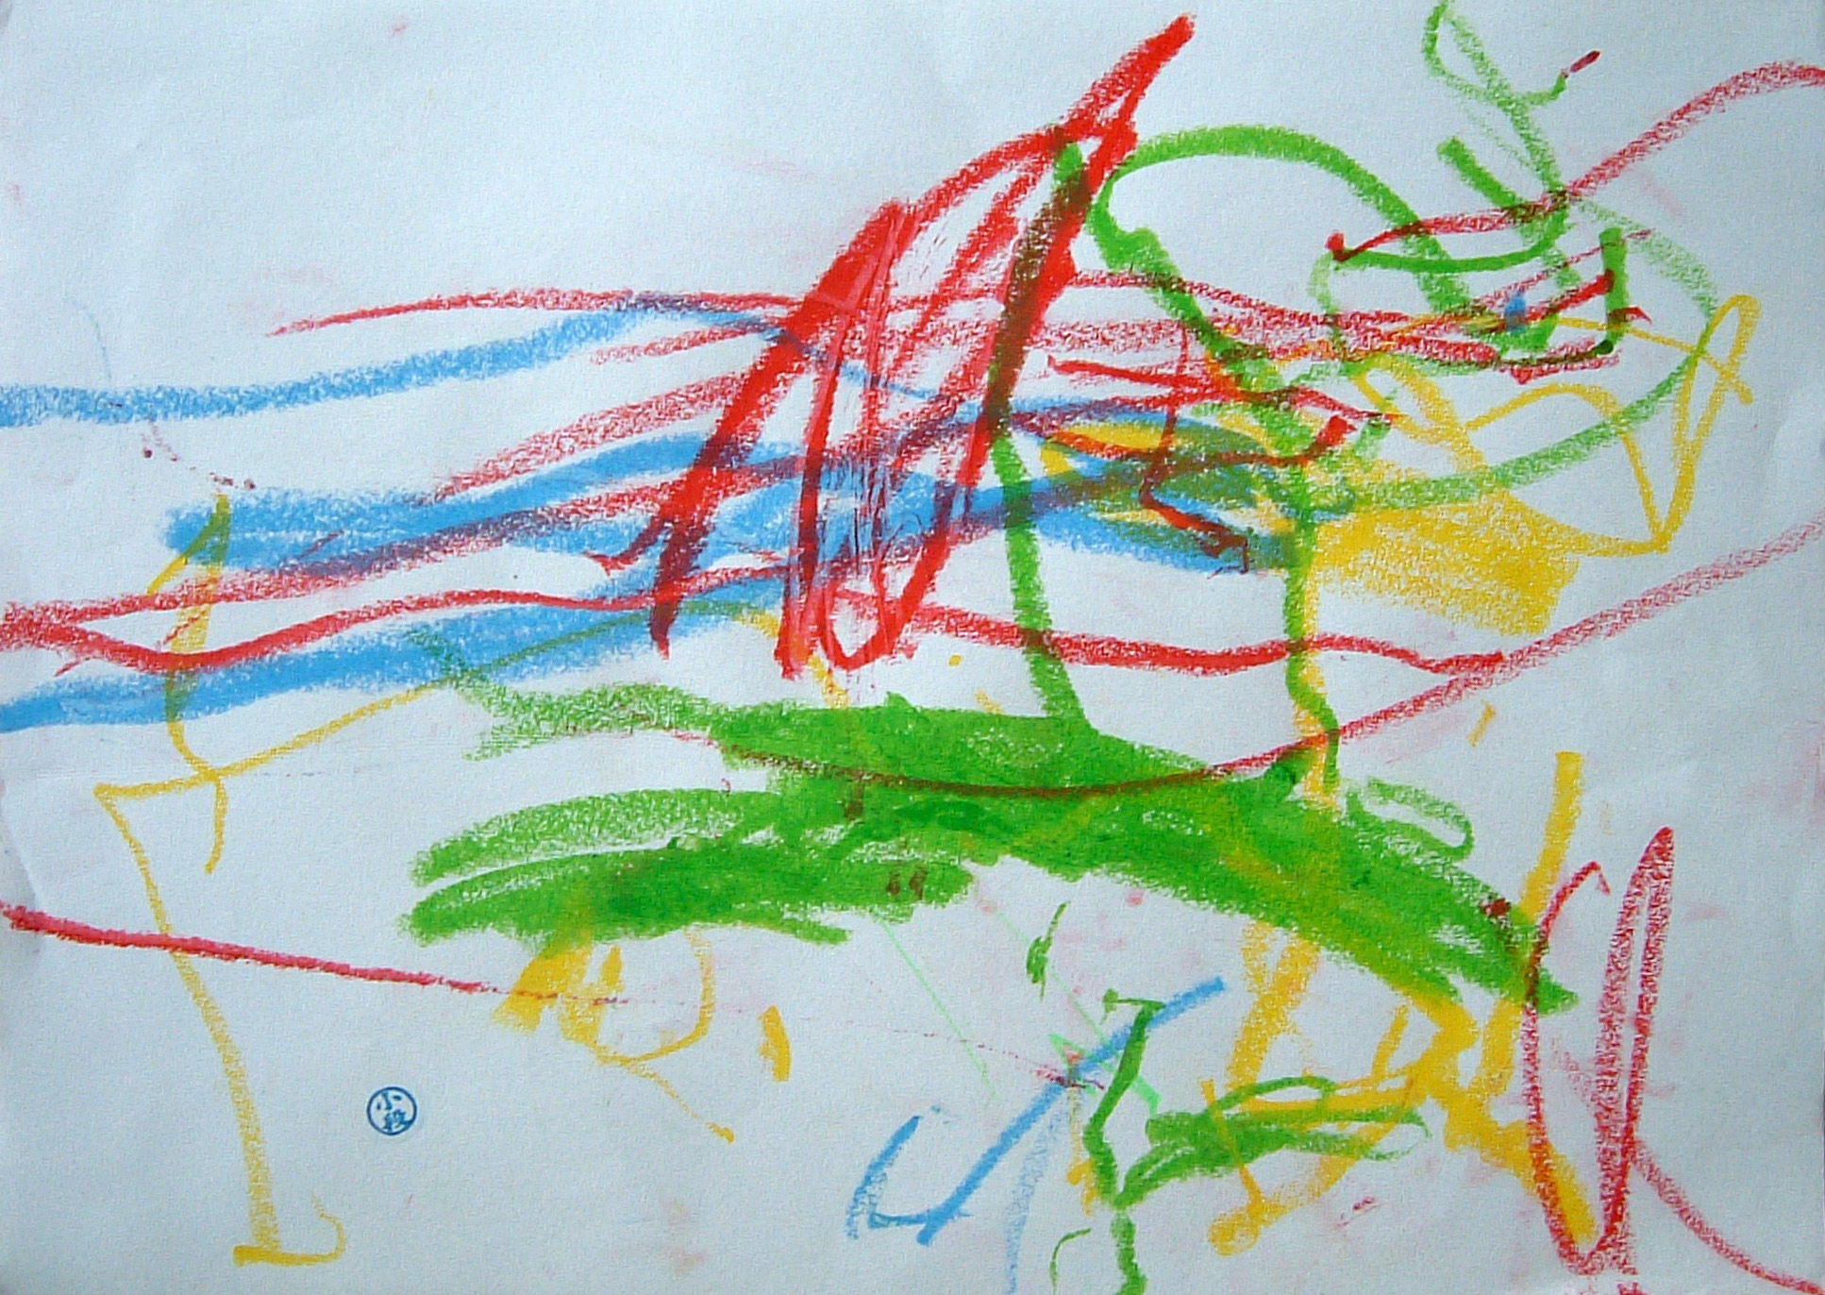

Writing
The role of mark making.
Supporting the children to make progress
Focusing on letter formation and spelling through LW phonics.

Slide 10

Little wandle and writing
"Down, up and over the mouse’s ears”

Slide 11
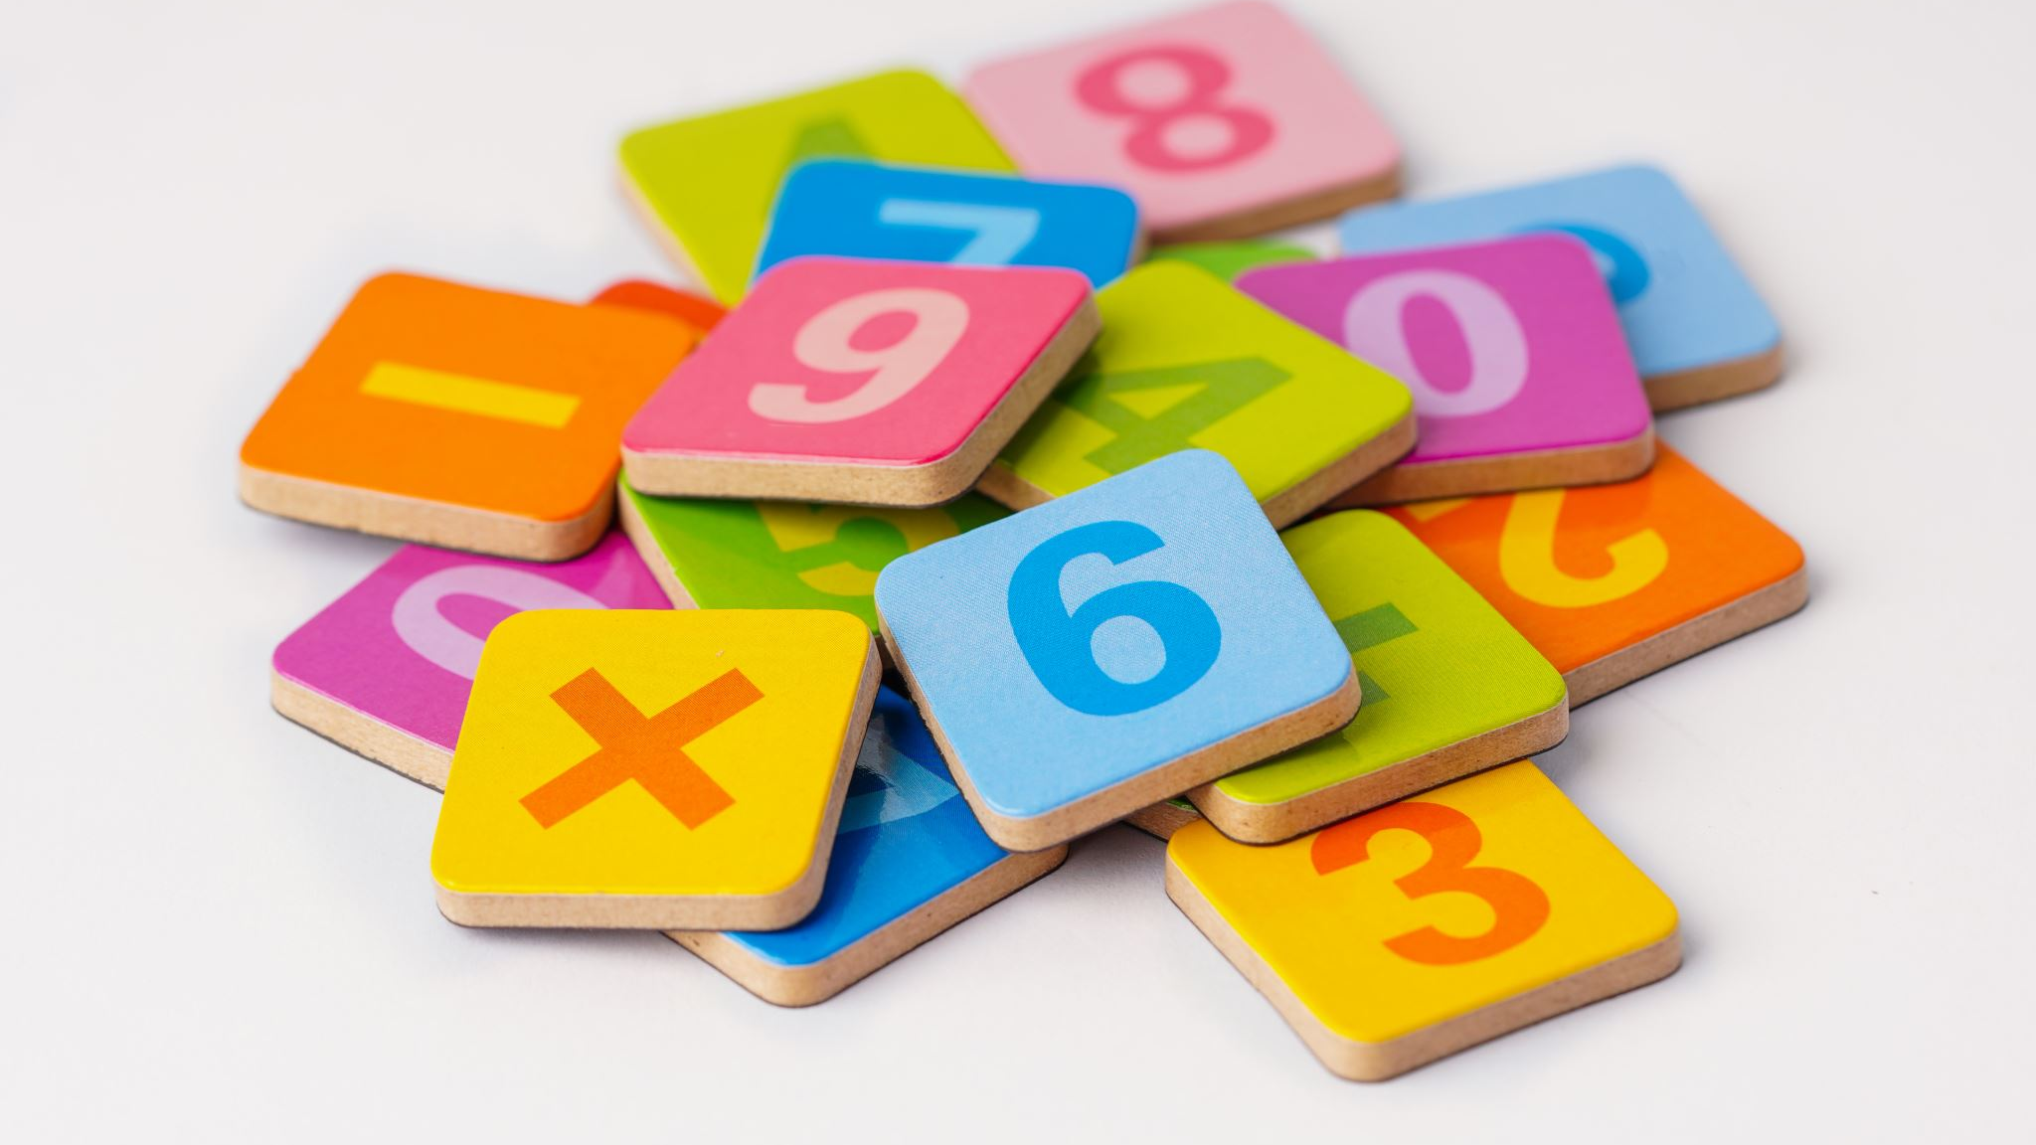
Maths
How we teach maths:
-We use 'Mastery number' programme which:
-Supporting fluency in number facts so they are recalled automatically
-Develop number sense- a flexibility with number (represent number or solve problems in more than one way)

Slide 12
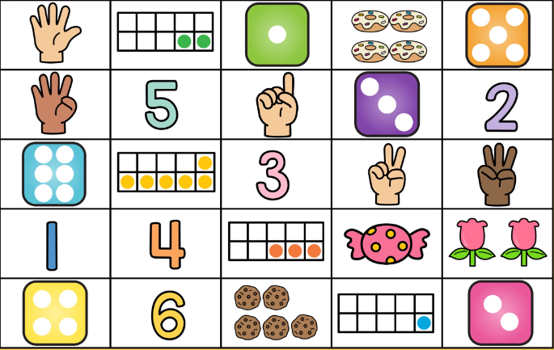
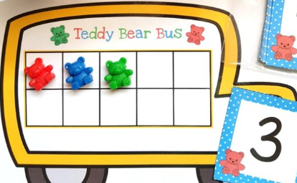
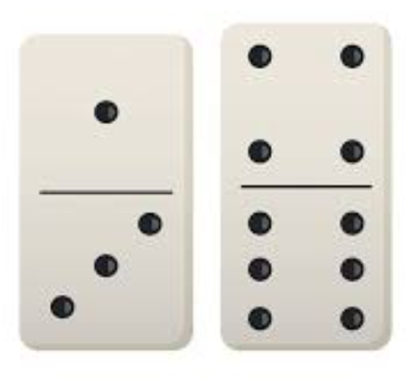
maths
- Concrete/pictorial/abstract
- Looking deeply at numbers up to 10 and counting beyond
- Subitising – automatically recognising how many in small amounts e.g. number on a dice
_ Cardinality of number – what is it that makes something one
- Composition of number –numbers are made up of combinations of smaller number (number bonds up to 5 e.g. 2 +3, 1 +4 and some up to 10)
- Space, Shape and Measure (shape, size, weight, capacity, position, distance, time, and money)
- Maths is all around us

Slide 13

Numbots -LOGINS WILL BE GIVEN -----
-online maths game playable at play.nobots.com or through numbots app
-playing the game little and often will help support your child's recall and understanding of:
*subitising
*number bonds
*addition
*subtraction

Slide 14



Knowledge of the world
PEOPLE AND COMMUNITIES
THE NATURAL WORLD
TECHNOLOGY

Slide 15

Expressive arts and design
-Children are provided with a variety of materials and tools to experiment and create their own work
-Adults model techniques & share artist's work
-Children given opportunities to explore musical instruments and introduced to a wide range of music
-resources to support role play and act out stories

Slide 16
Reminders:
PPA/ PE day
Library
Attendance/ absences
Label everything!
Parent readers/ helpers
Share your experiences
PTA
Website

Slide 17
We're here to help...
Sjohnson@ashtongateprimary.org
kchapman@ashtongateprimary.org
csands@ashtongateprimary.org
khoughton@ashtongateprimary.org
sford@ashtongateprimary.org
lcarkeek@ashtongateprimary.org
sjohnson@ashtongateprimary.org

