Slide 1
Possessive apostrophes

Slide 2
Learning Objective
We are learning how to use the apostrophe to indicate possession with both singular and plural nouns.

Slide 3
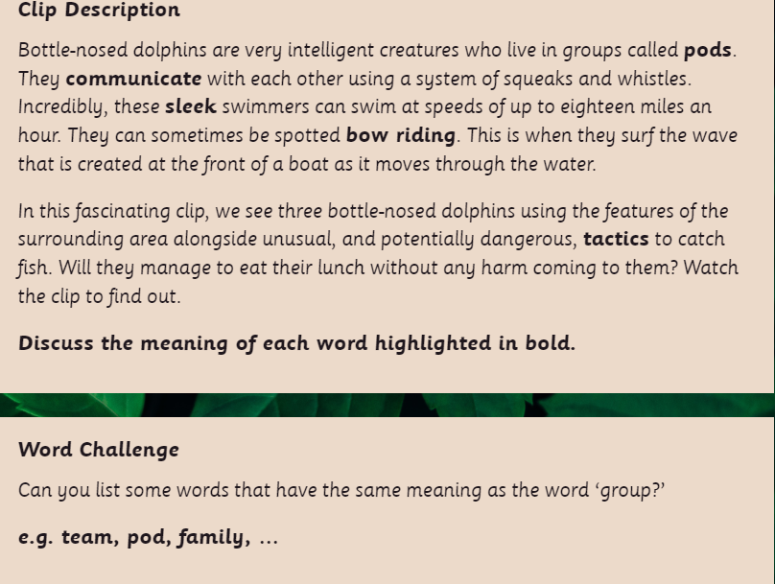
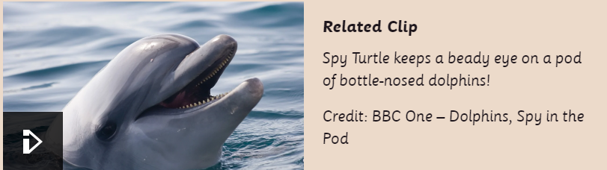
https://www.bbc.co.uk/programmes/p039ck24/player
https://www.bbc.co.uk/programmes/p01nxr9m

Slide 4
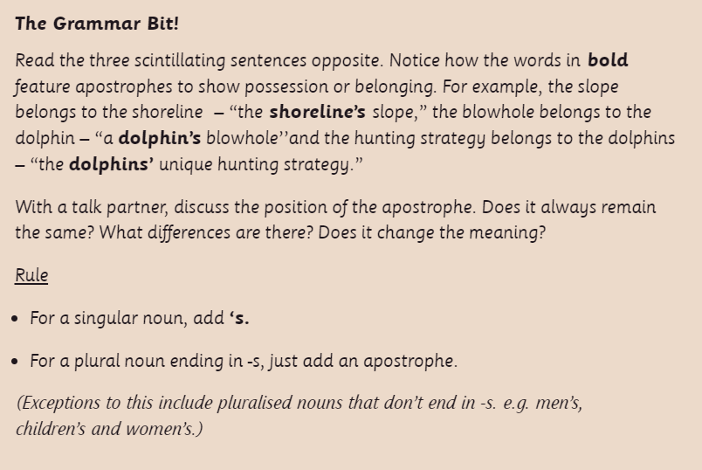

Slide 5
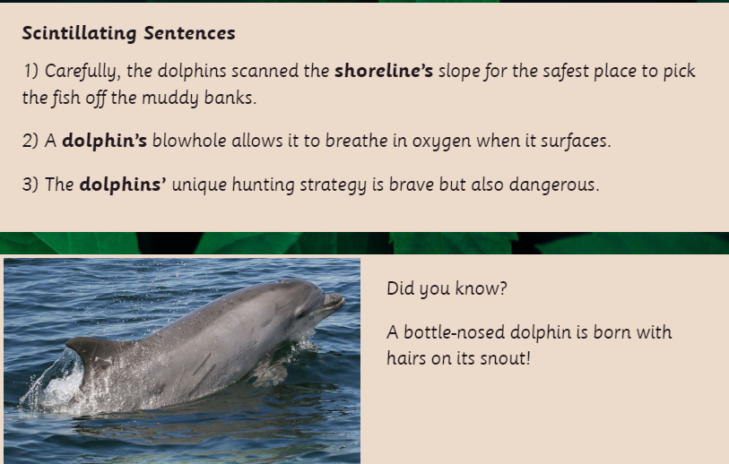

Slide 6
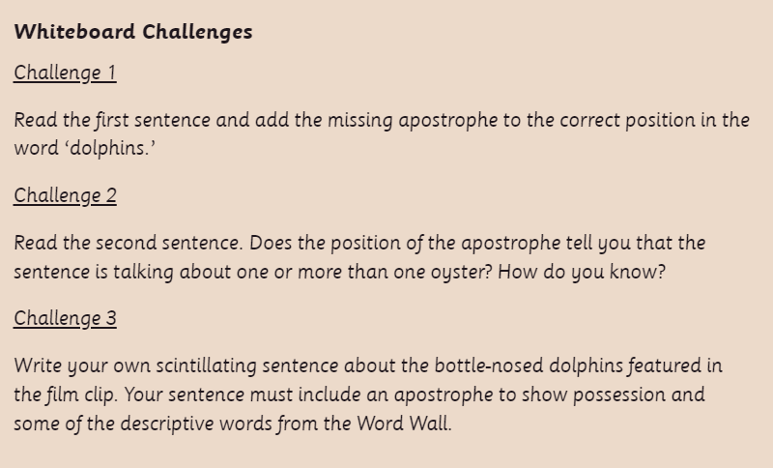

Slide 7
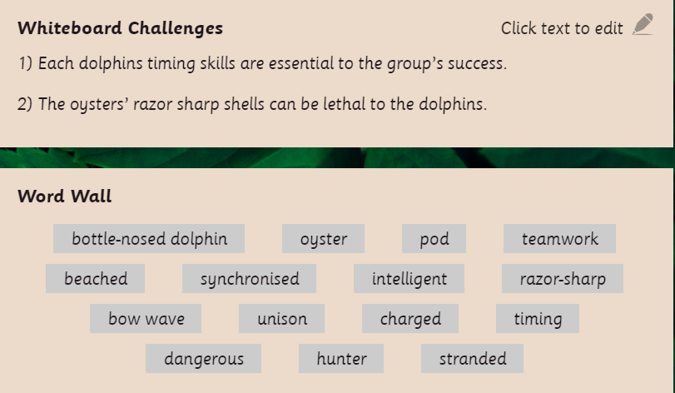

Slide 8
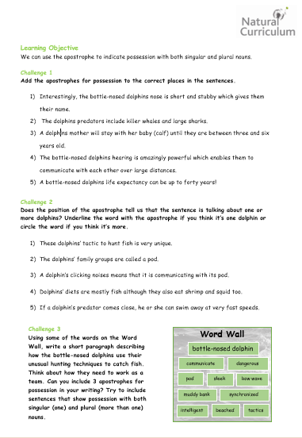
Complete the worksheet

