Slide 1

Meet & Greet – Y5
Ashton Gate
Primary School

Slide 2


Rising High Together
ASHTON GATE PRIMARY SCHOOL

Slide 3

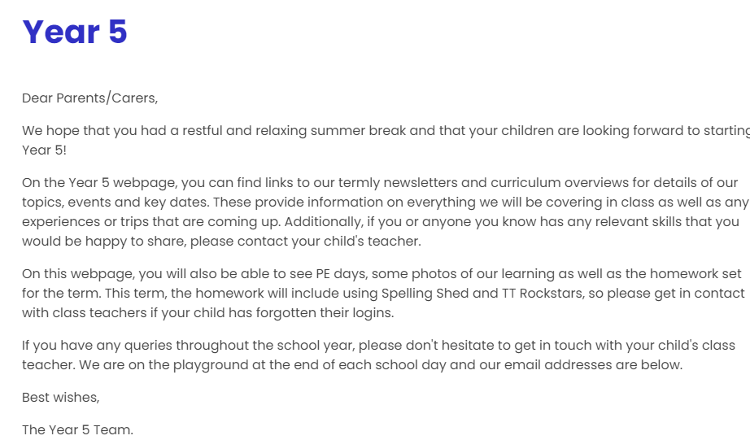

Website Ashton Gate Primary School - Home
Term dates
Year group newsletters
Term overviews
Overview of events
Policies
ASHTON GATE PRIMARY SCHOOL

Slide 4
Outline of day-
8.40-8.50- children come in, register and complete morning work.
Session 1
10.15- assembly on Monday, Thursday (singing) and Friday.
10.35-10.50- Break
Session 2
12.30-1.30- Lunch
Session 3
3.10- Hometime
ASHTON GATE PRIMARY SCHOOL

Slide 5

Homework
Spellings
Spellings are on the website – Test each Friday – handed out on a Monday.
ASHTON GATE PRIMARY SCHOOL

Slide 6
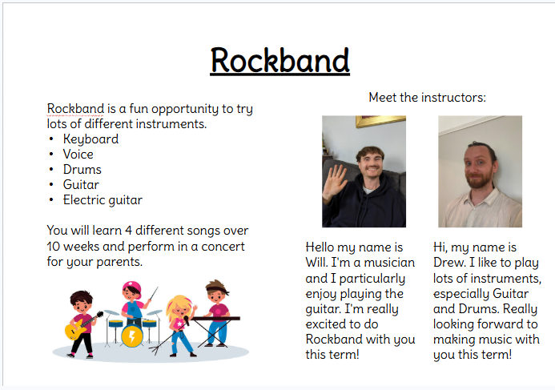

Slide 7
Trips and experiences:
Windmill Hill City Farm – science focus
Court trip – PSHE democracy and justice
Traffic Survey – Geography
Graffiti Walk – Art
Trinity Centre – Music Concert
BMX day – PE
Year 5 sports day – PE
Rockband – Music
Oceans workshop - Geography
ASHTON GATE PRIMARY SCHOOL

Slide 8



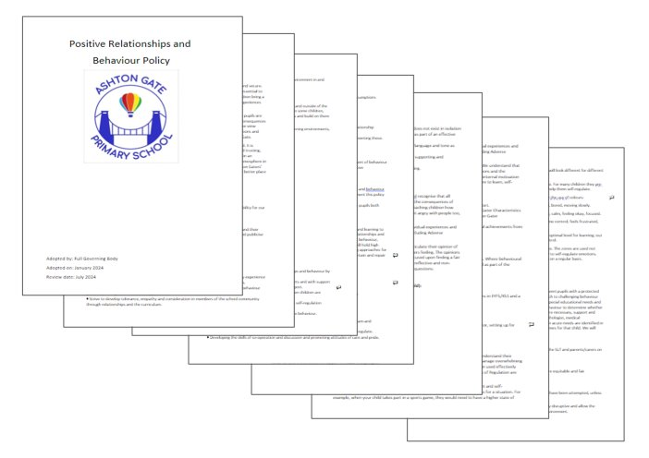
Ashton Gaters
Positive Relationships and Behaviour Policy- on the website- please have a read!
ASHTON GATE PRIMARY SCHOOL

Slide 9
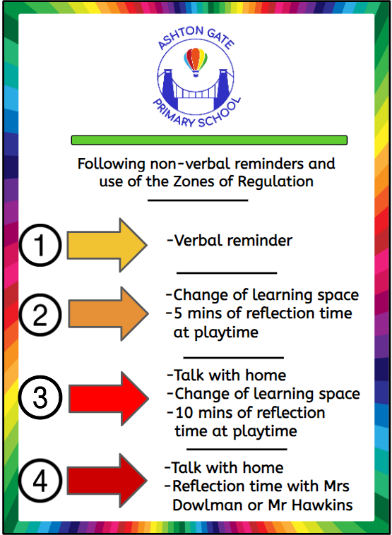
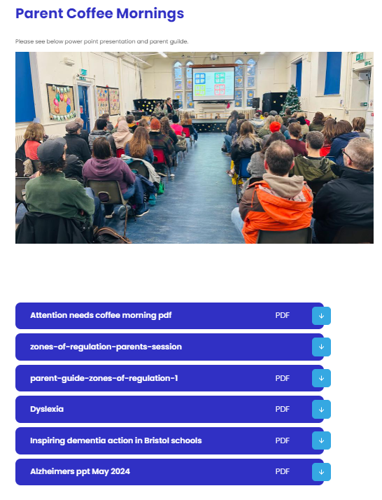
Behaviour
ASHTON GATE PRIMARY SCHOOL

Slide 10
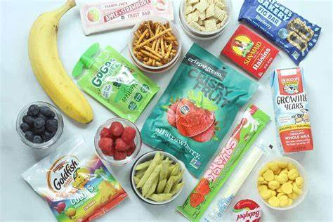

Healthy Snacks/Nut free
ASHTON GATE PRIMARY SCHOOL

Slide 11
Reminders:
School uniform- no jewellery
Library books
Attendance/ absences on Arbor
Label everything!
School camp next year
ASHTON GATE PRIMARY SCHOOL

Slide 12
Year 5 End of Day
If you would like your child to walk home alone, please complete a permission form with the office.
Children being collected are dismissed from the back playground. After school club now collected from the back playground.
ASHTON GATE PRIMARY SCHOOL

Slide 13
ASHTON GATE PRIMARY SCHOOL

