Slide 1

Meet & Greet – Year 6
Welcome to 6C
Ashton Gate
Primary School

Slide 2

Website: www.ashtongate.bristol.sch.uk
Term dates
Term overviews
Homework and spellings
Photos
Policies
ASHTON GATE PRIMARY SCHOOL

Slide 3

Outline of day
8.30am- children are met at the door and come into class and complete morning work.
8.40 Register
8.55 – 10.15 English lessons
(reading, handwriting, spelling, writing)
10.15-10.35am Assembly (Mon, Thu, Fri)
10.35-10.50am Morning break
10.55-12.30- Maths, times tables
12.30-1.30pm – lunchtime
1.30-3pm – Afternoon lessons
3pm- End of school (children collected from the front or if they have permission are able to walk home)
It is essential that all children arrive as close to 8.30 as possible.
The morning work usually reinforces a key skill for SATs, because this time of day is when the children are the most calm, alert and focused.
ASHTON GATE PRIMARY SCHOOL

Slide 4
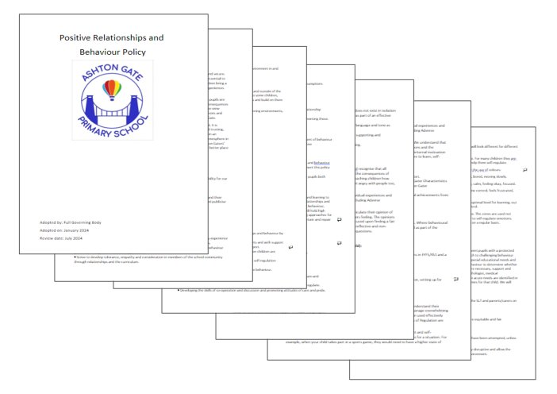



Ashton Gaters
Positive behaviour:
House points
Hot chocolate
Certificates (Ashton Gater, Learner of the Week or Game Changer)
Positive Relationships and Behaviour Policy is on the website.
ASHTON GATE PRIMARY SCHOOL

Slide 5
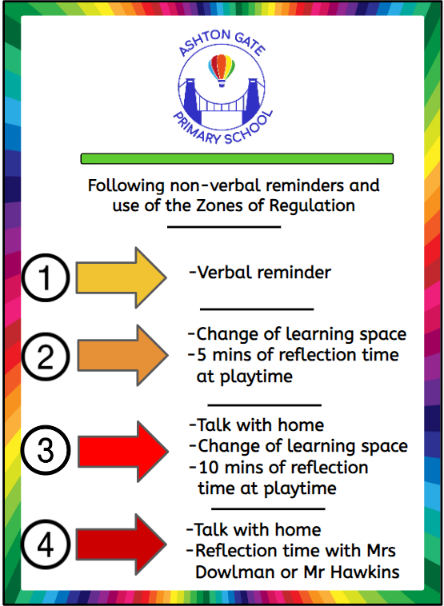
Behaviour Curriculum:
Wonderful walking
Ready to Learn
Manners Matter
STAR Listening
The senior leadership team can be contacted (as well as myself) regarding any behavioural concerns or incidences.
Mr Alex Hawkins is the Designated Safeguarding Lead and is in charge of the behaviour curriculum.
ASHTON GATE PRIMARY SCHOOL

Slide 6

Homework and spelling
Check the website for details!
Homework will be set generally on Fridays and should be returned by the following Wednesday, to be discussed in class before the next week’s is set.
There are no official weekly spelling tests, but we have put together a list of suggested words that follow the spelling concepts being taught in class, which would be helpful for your child to practice at home. (The concepts/patterns we are teaching are the patterns which are likely to come up in a SATs spelling test).
From term 2, your child will bring home 2 CGP textbooks - 1 arithmetic and 1 grammar. We will set specific pages linked to what we have been learning in class.
Next term we will also have a homework project linked to our history unit on WW1 - more details to follow!
ASHTON GATE PRIMARY SCHOOL

Slide 7
Other home learning
Please encourage your child to read regularly.
If your child is not yet confident with their times tables, please practice these with them for quick recall. (Times table rockstars is still available to use too)
We can also send home additional materials if we/you think it could be helpful closer to SATs.
Please avoid giving your child past SATs papers to complete without checking with us first, as we will be doing these as part of our assessments every term in school and it could artificially inflate their data.
ASHTON GATE PRIMARY SCHOOL

Slide 8
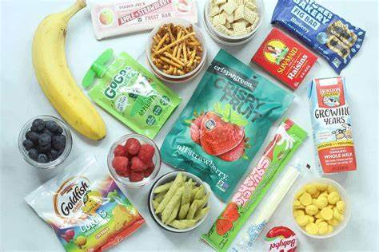

Healthy Snacks/Nut free
ASHTON GATE PRIMARY SCHOOL

Slide 9
Reminders:
PE (generally on Tuesdays)- your child should come wearing their PE kit.
If your child is going to be absent, please let the office know
Remind your child to bring their water bottle
Mobile phones and smart watches are handed in at the start of the day
Please label everything! – Especially once they have their leavers’ hoodie!
Parent helpers will be needed for some trips, so thank you in advance! (first few trips are to Bristol Old Vic (Children’s Bookshow) and St George’s
ASHTON GATE PRIMARY SCHOOL

Slide 10

Monday 10 May to Thursday 13 May 2027.
Monday : Grammar, punctuation, and spelling test
Tuesday : Reading
Wednesday : Arithmetic and Reasoning 1
Thursday : Reasoning 2
ASHTON GATE PRIMARY SCHOOL

Slide 11
There are clear guidelines which we have to follow.
The tests take place in the classroom. If a child has access arrangements, they might sit their test in a different room.
Throughout the year, we will spend a lot of time preparing the children for the tests, including practicing test conditions and access arrangements.
We will hopefully run an after school SATs club later in the year. We will invite children, who will particularly benefit from these sessions, to participate.
We also continue to teach a broad and balanced curriculum, which helps prepare them for year 7 and beyond. The main message we want them to have is ‘try your best’.
ASHTON GATE PRIMARY SCHOOL

Slide 12
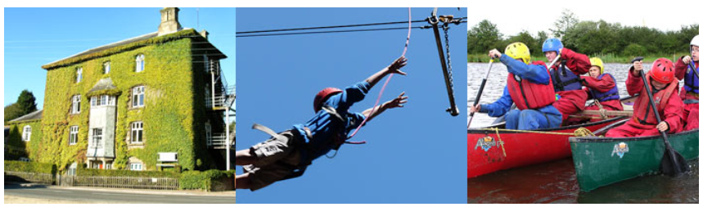
Year 6 Camp - Deanfield
After a very successful trip this summer, Year 6 Camp will again be at Deanfield Outdoor Centre in Gloucestershire in summer 2027.
Year 6 Camp will be after SATs, between Monday 28thJune and Friday 2nd July 2027.
2 classes will go from Monday to Wednesday and 2 classes from Wednesday to Friday: it is a 3-day trip with 2 nights on-site. (Which classes will go when will not be decided until Term 3)
There will be a drop-in Q&A session on Monday 28th September from 3.20 – 3.45pm in 5MC’s classroom.
ASHTON GATE PRIMARY SCHOOL

Slide 13

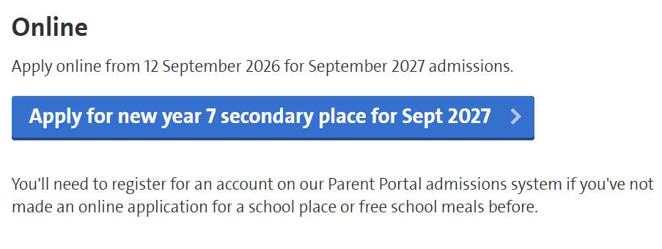
The deadline for applications is 31st October.
Our Ashton Gaters go to a wide range of secondary schools and we would recommend that you go and visit a few with your child and get a feel for them.
Talk to people you know about their experiences of different secondary schools and look at their websites.
In term 5 and 6, we start to prepare your child for moving on to Y7. We talk about many aspects of the transition to secondary- their worries, what will be different, how to be organised, ways to make new friendships etc
ASHTON GATE PRIMARY SCHOOL

Slide 14
Any questions?
ASHTON GATE PRIMARY SCHOOL

