Slide 1

Meet & Greet – Year 6
Ashton Gate
Primary School

Slide 2


Rising High Together
ASHTON GATE PRIMARY SCHOOL

Slide 3
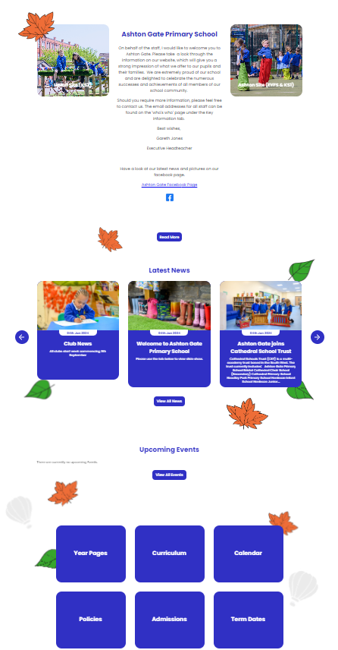

Website: https://www.ashtongate.amplifyeducation.co.uk/
Term dates
Term overviews
Overview of events
Policies
ASHTON GATE PRIMARY SCHOOL

Slide 4
Outline of day
8.30am- children are met at the door and come into class and complete morning work.
8.40 Register
8.55 – 10.15 English lesson
10.15-10.35am Assembly
10.35-10.50am Morning break
10.55-12.30- Maths, times tables
12.30-1.30pm – lunchtime
1.30-3pm – Afternoon lessons
3pm- End of school [children collected from outside the side door or if they have permission are able to walk home]
It is essential that all children are in on time. This is one of the best opportunities we have to support your child and prepare them for SATS.
ASHTON GATE PRIMARY SCHOOL

Slide 5





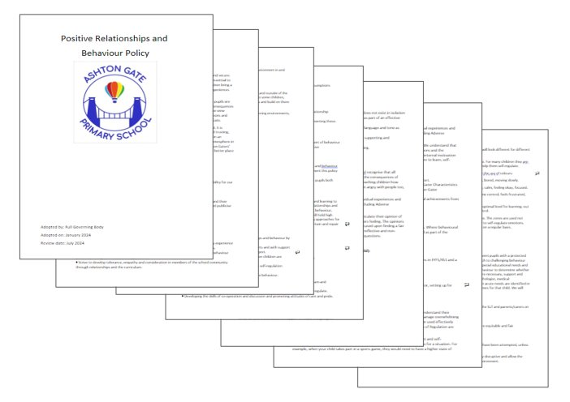
Ashton Gaters
Positive Relationships and Behaviour Policy- on the website- please have a read!
ASHTON GATE PRIMARY SCHOOL

Slide 6
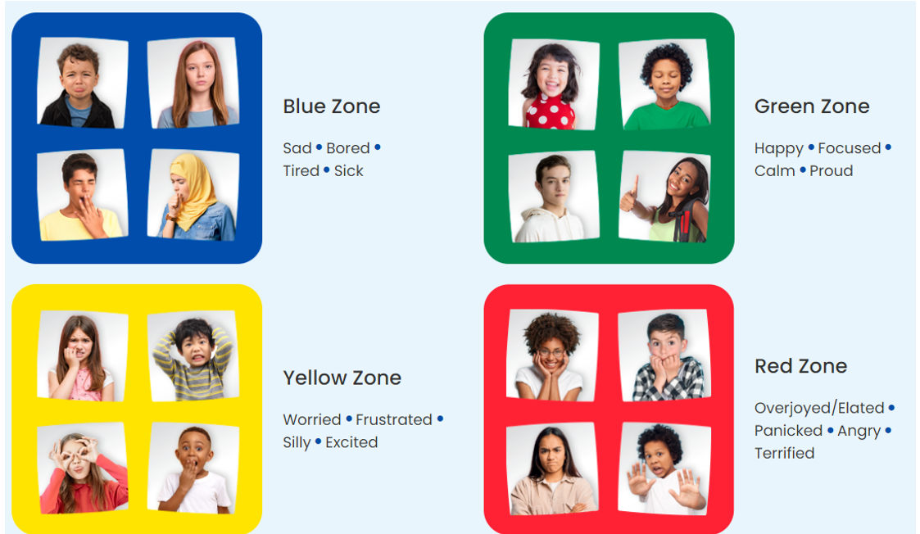
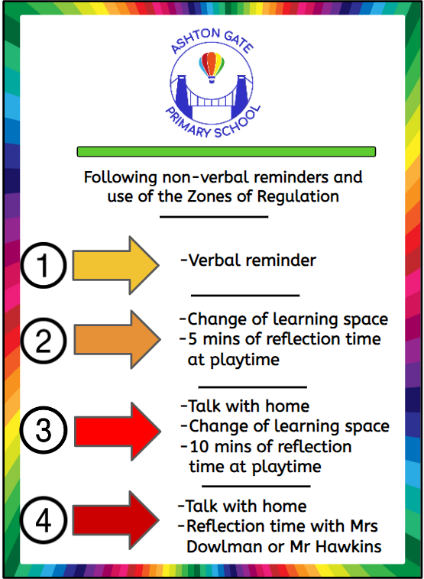
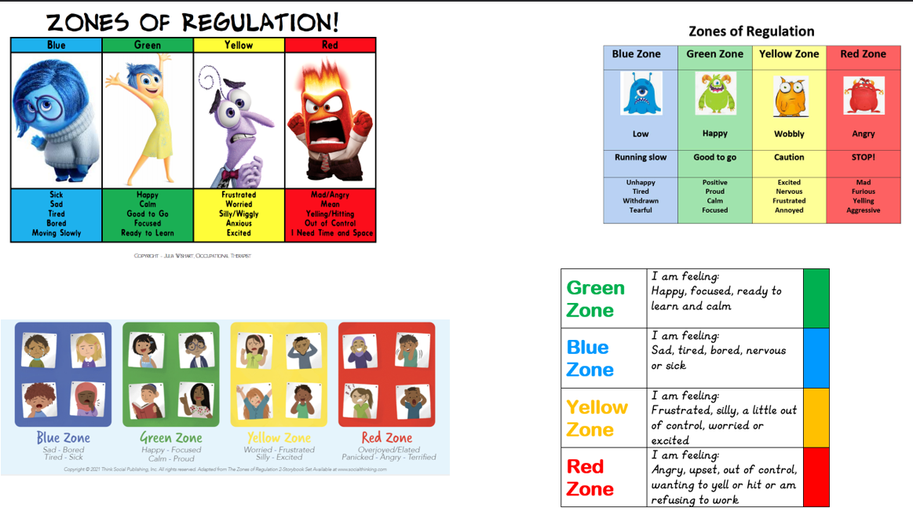
Behaviour/ zones of regulation
Behaviour Curriculum:
Wonderful walking
Ready to Learn
Manners Matter
STAR Listening
ASHTON GATE PRIMARY SCHOOL

Slide 7
Homework
Homework will be set on Fridays and should be returned the following Wednesday.
Currently, homework is on the school website.
Soon, your child will bring home 2 textbooks - 1 maths and 1 for Grammar/Punctuation. The pages that are selected link to the children’s learning in class. Next term we will also have a homework project linked to our history unit on WW1 - more details to follow!
There is a section on the website called ‘Support for Parents’ which has step-by-step explanations for the arithmetic skills we teach in year 6.
Date set: Friday 12th September Date due in: Wednesday 17th September | Date set: 19th September Date due in: Wednesday 24th September
In English, we have been practising using subordinate clauses. Complete pages 24 and 25 in your Grammar book. | This week in maths we have focused on addition and subtraction skills. Work through pages 2 and 4 in your Arithmetic book to build your fluency.
Date set: Friday 26th September Date due in: Wednesday 1st October | Date set: Friday 3rd October Date due in: Wednesday 8th October
We have practised recognising different word classes. Complete page 2 on nouns and page 9 on verbs in your Grammar book. | We have now also practised our multiplication and division skills. Complete page 13 and 17 in your Arithmetic book to build your fluency multiplying numbers.
Date set: Friday 10th October Date due in: Wednesday 15th October | Date set: Friday 17th October Date due in: Wednesday 22nd October
Please complete pages 6 &7 on pronouns in your Grammar book. | Please complete page 10-11 in your Arithmetic book. Spend this week practicing any times tables you find tricky at home.
ASHTON GATE PRIMARY SCHOOL

Slide 8
Spellings and reading books
A list of spellings that we are covering for the term can be found on the website.
Your child should be reading at least 3x a week. We would encourage you to listen to them read and discuss their books alongside independent reading.
ASHTON GATE PRIMARY SCHOOL

Slide 9
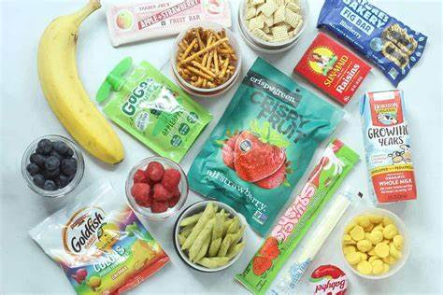

Healthy Snacks/Nut free
ASHTON GATE PRIMARY SCHOOL

Slide 10
Reminders:
PE - your child should come wearing their PE kit.
If your child is going to be absent, please let the office know
Remind your child to bring their water bottle - named
Mobile phones are handed in
Please label everything! – Especially once they have their leavers jumper
Parent helpers- lots of trips so thank you in advance!
Events this term:
Individual School Photos – Tuesday 6th October
NCMP Screening – Monday 12th October
Flu Vaccination – Friday 16th October
Papaya workshop – Tuesday 20th October
Jeremy Banning WW1 talk – Friday 23rd October
ASHTON GATE PRIMARY SCHOOL

Slide 11

Times Tables practice
Fluent recall of times tables is essential for success during SATs and for general progress!
Please work with your child on their number knowledge or encourage them to spend some time each week on TT Rockstars.
ASHTON GATE PRIMARY SCHOOL

Slide 12

Monday 10 May to Thursday 13 May 2027.
The tests cover English reading, English grammar, punctuation, and spelling, and mathematics.
Monday : Grammar, punctuation, and spelling test
Tuesday : Reading
Wednesday : Arithmetic and Reasoning 1
Thursday : Reasoning 2
ASHTON GATE PRIMARY SCHOOL

Slide 13
There will be a SATs meeting for parents and carers on Tuesday 12th January at 2:30pm.
There are clear guidelines which we have to follow.
The tests take place in classrooms, sometimes children will work in a smaller group for a range of reasons.
Throughout the year, we will introduce your child to the tests, the question types and the length of time they have to complete them, so they feel prepared.
We will hopefully run an after school SATs club. We will invite children, who will particularly benefit from these sessions, to participate.
We also continue to teach a broad and balanced curriculum, which helps prepare them for year 7 and beyond. The main message we want them to have is ‘Try your best’.
ASHTON GATE PRIMARY SCHOOL

Slide 14

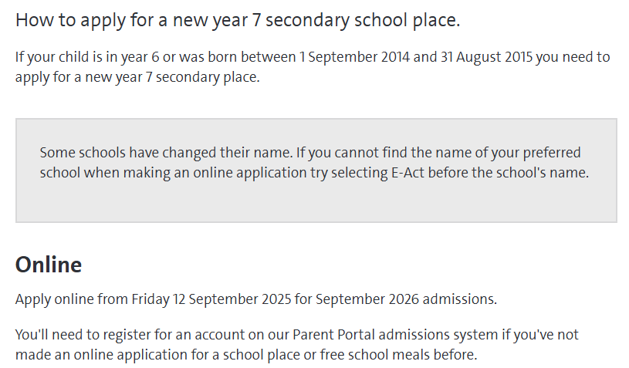
The deadline for applications is 31st October.
In term 5 and 6, we start to prepare your child for moving on to Y7. We talk about many aspects of the transition to secondary- their worries, what will be different, how to be organised, ways to make new friendships etc
Our Ashton Gaters go to a wide range of secondary schools and we would recommend that you go and visit a few with your child and get a feel for them.
Talk to people you know about their experiences of different secondary schools and look at their websites.
ASHTON GATE PRIMARY SCHOOL

Slide 15
Any questions?
ASHTON GATE PRIMARY SCHOOL

