Slide 1
Zones of Regulation

Slide 2
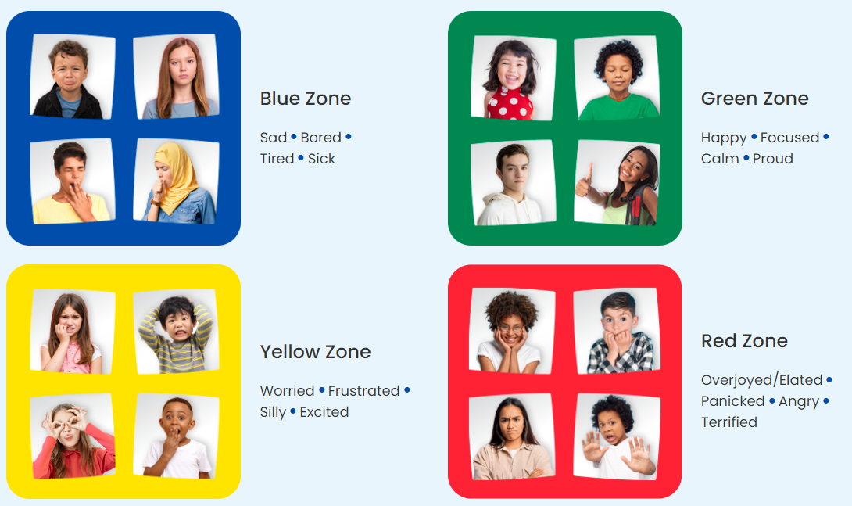

Slide 3
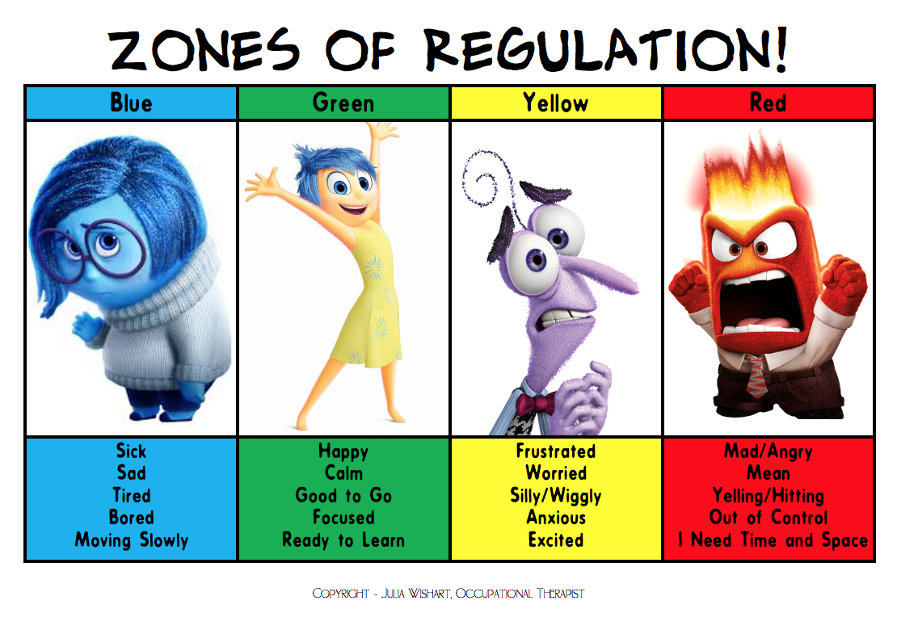
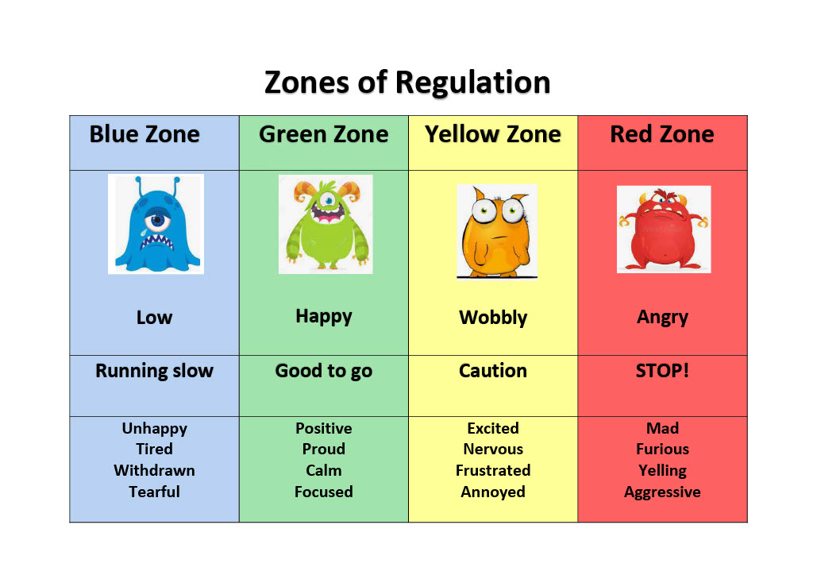
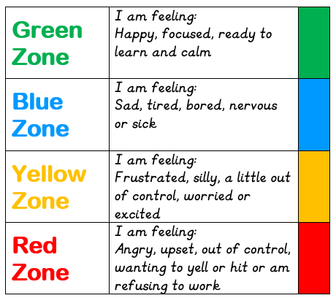
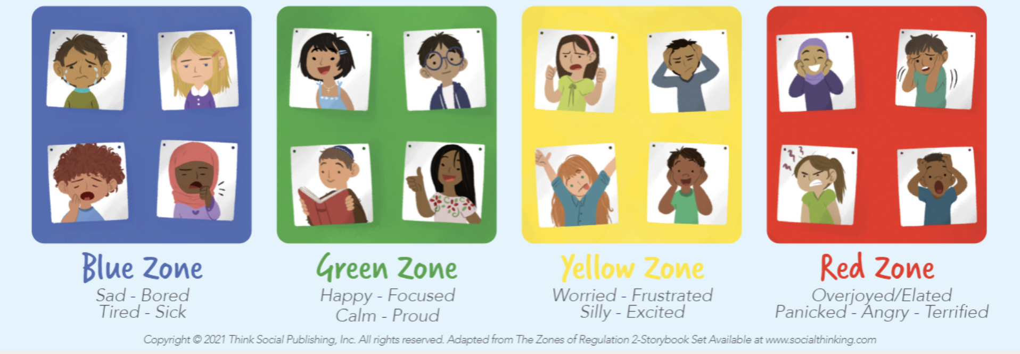

Slide 4
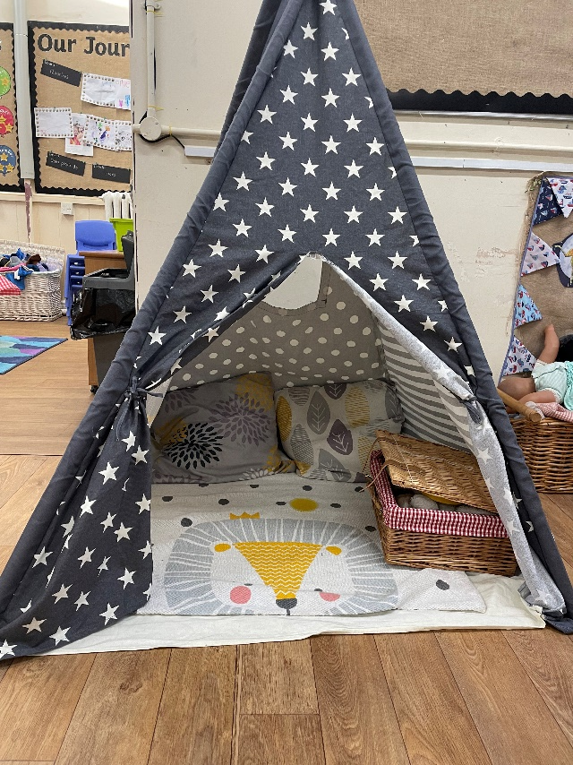
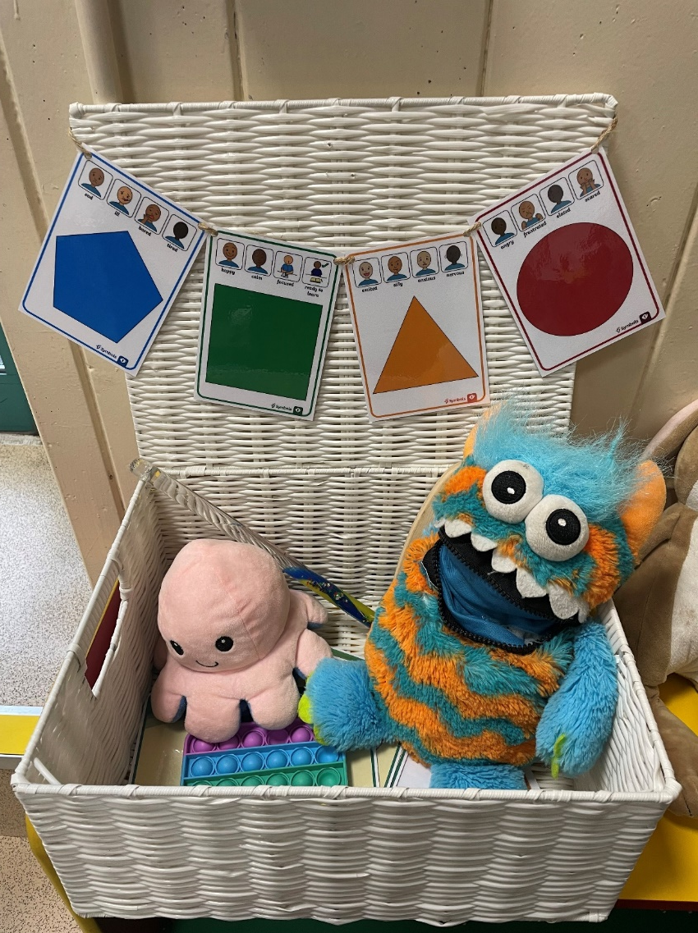
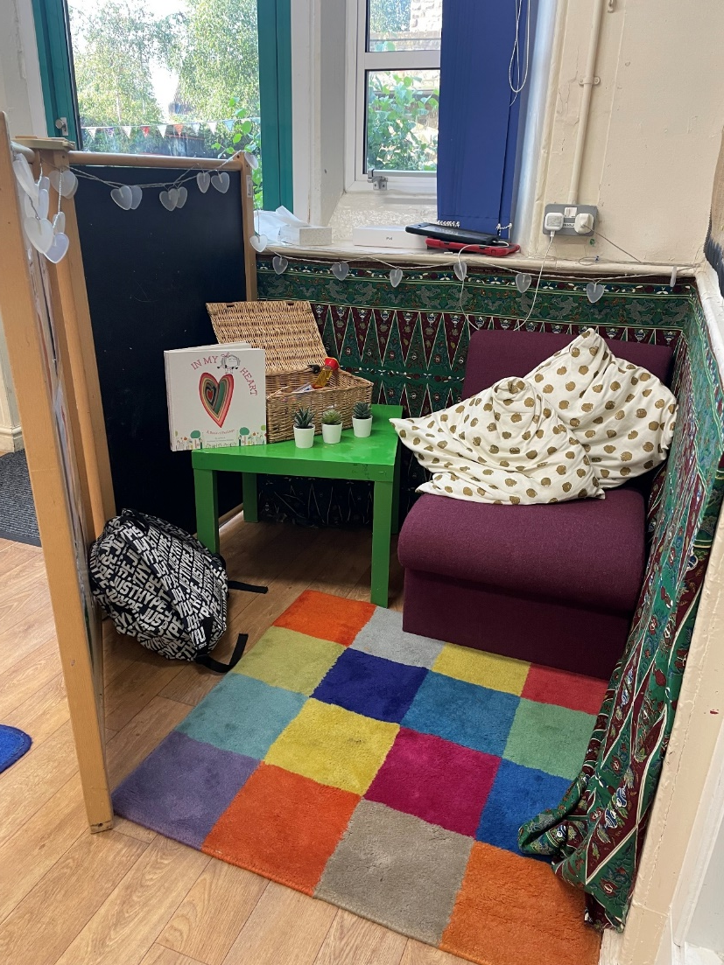
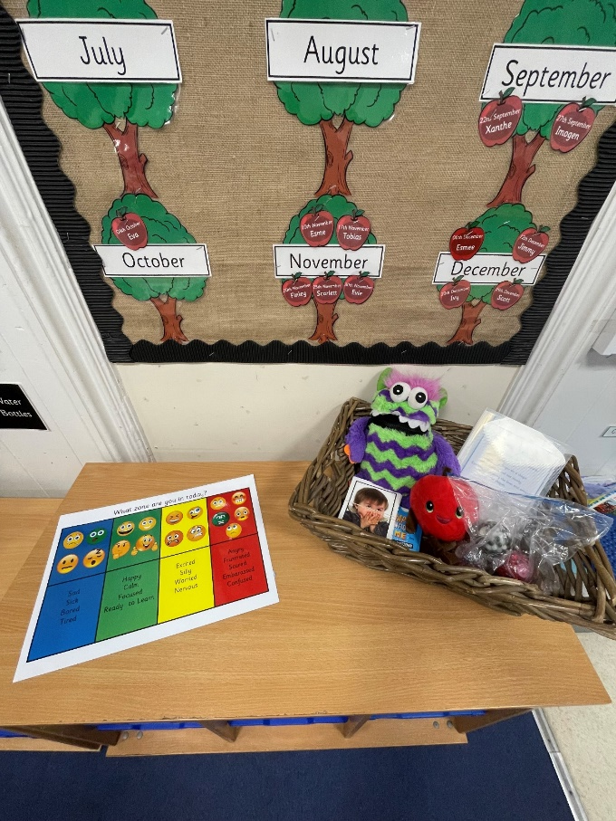

Slide 5
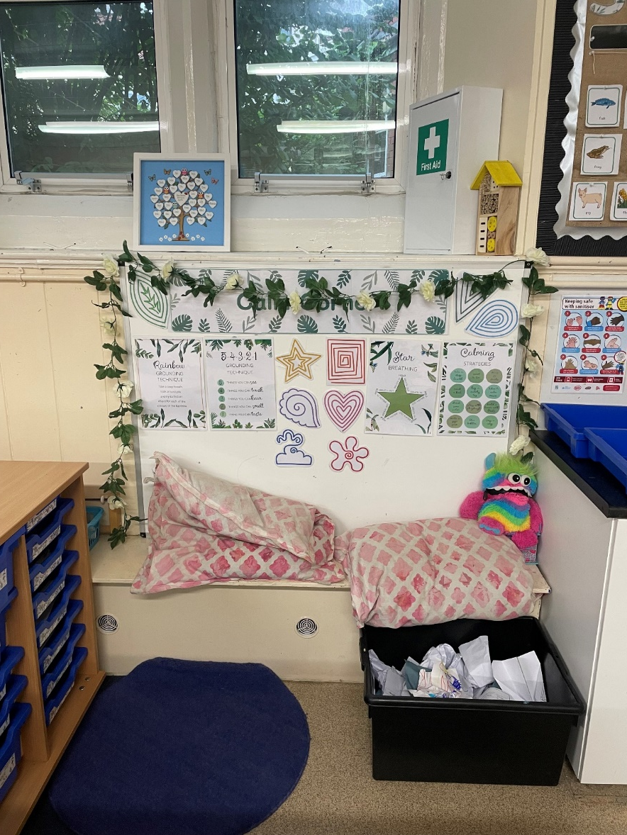
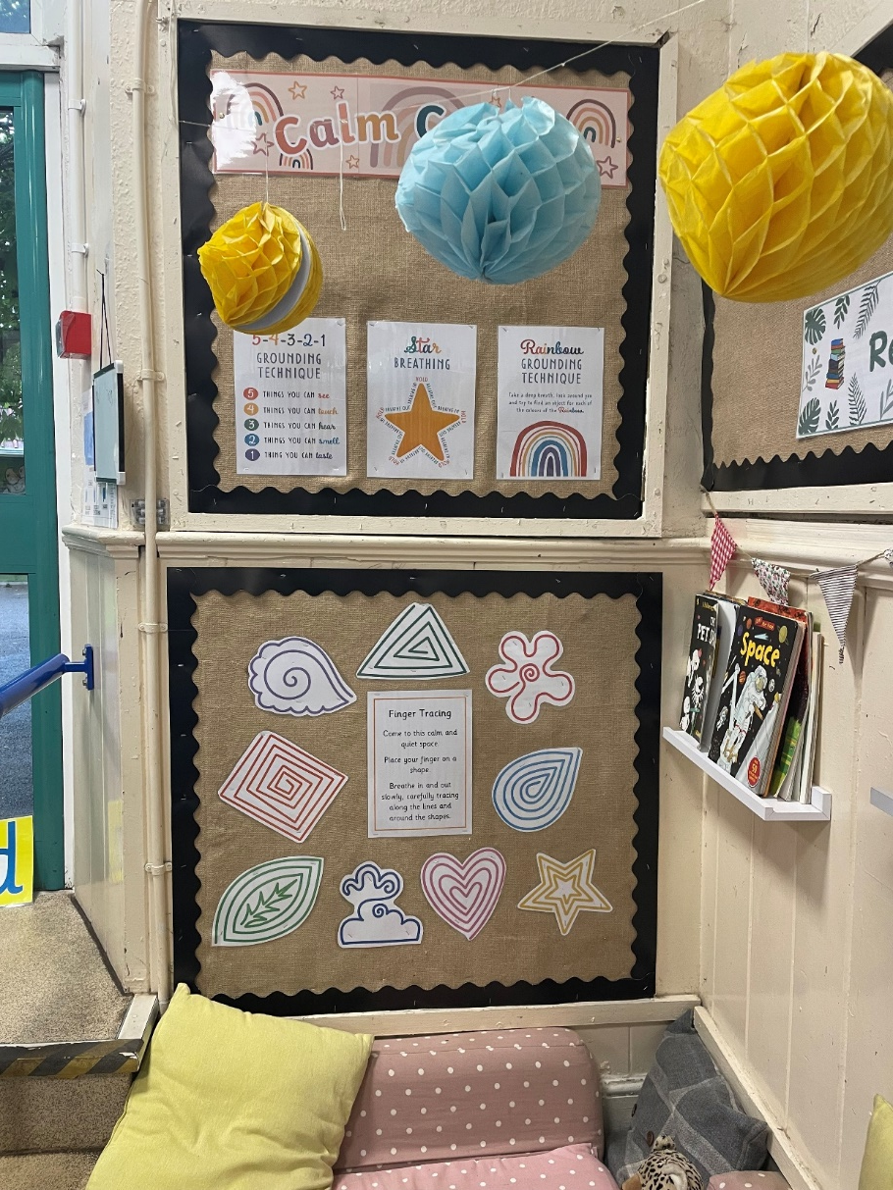
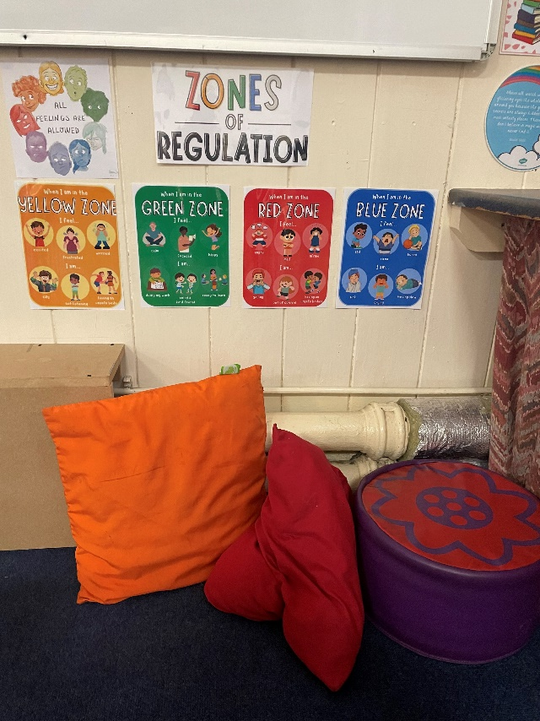

Slide 6
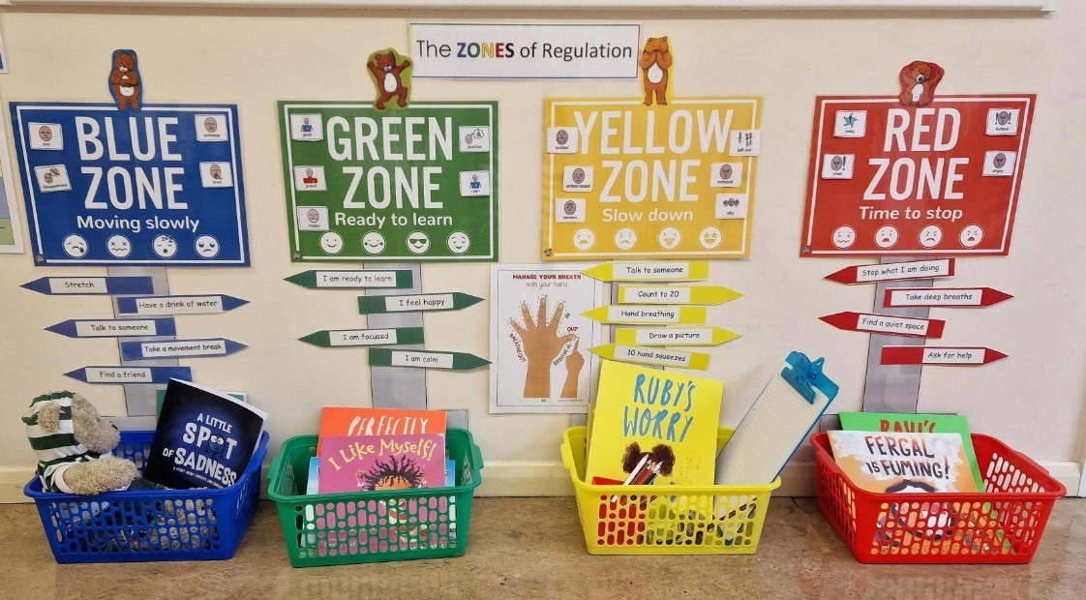
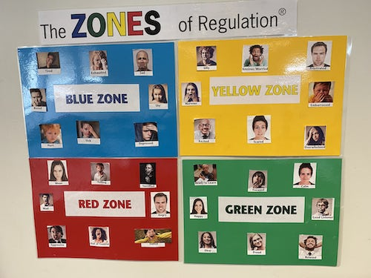
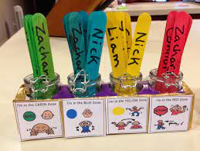
Zones of Regulation Check-in

Slide 7
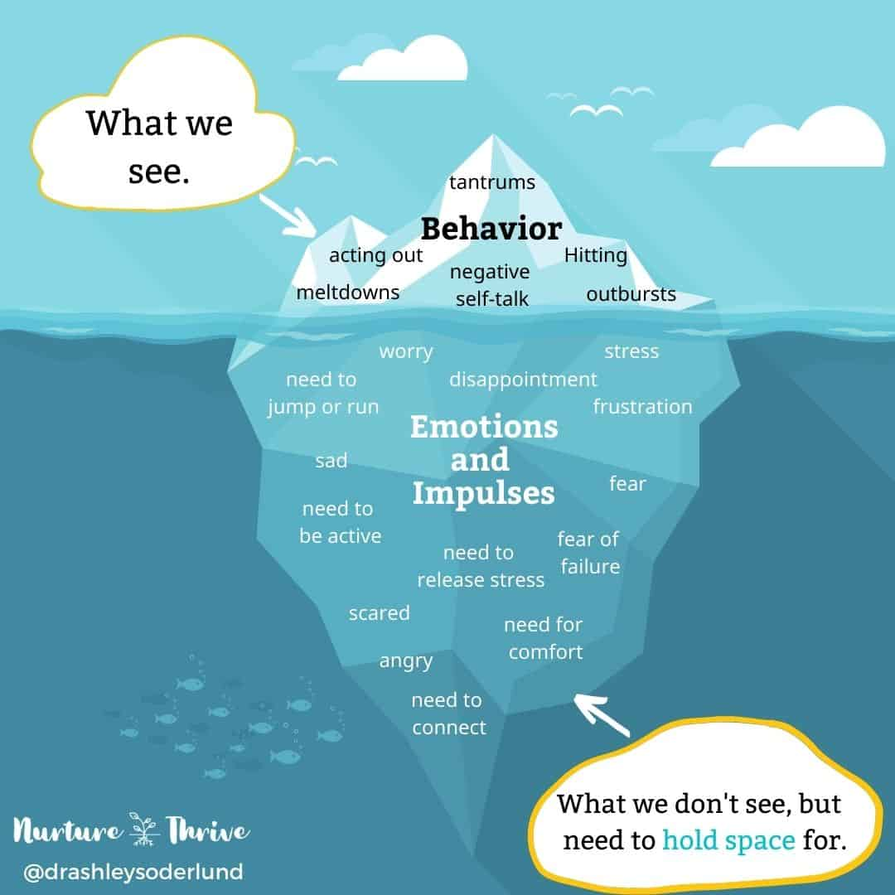
Zone of regulation: the theory
All Behaviour is an expression of a need

Slide 8
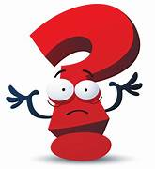
What is emotional regulation?
self -regulation
co-regulation
dysregulation

Slide 9
Introspection
What is my body telling me?
Regulation
Expression
Repair / refocus

Slide 10

Why the zones?
Inclusive / universal
Non judgmental
Vague – opens up opportunities for connection

Slide 11
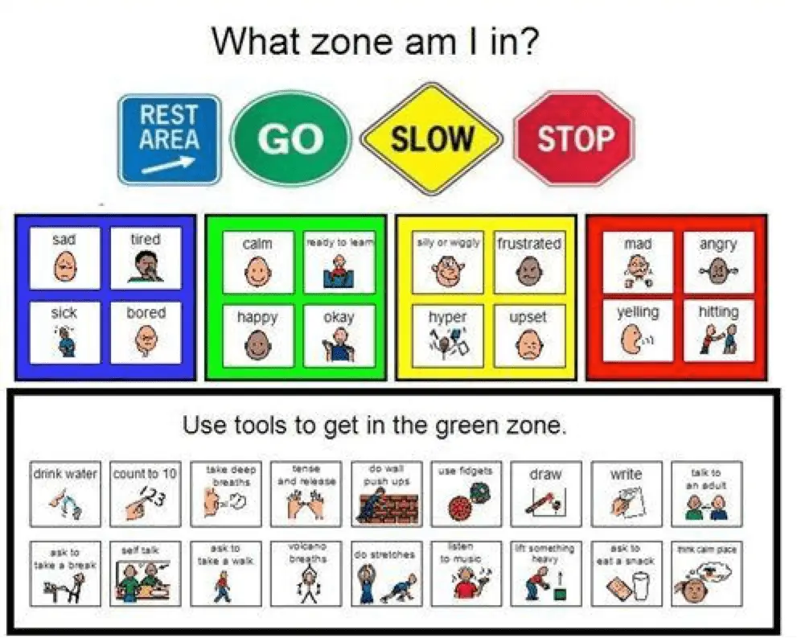
Emotions = energy in motion
All zones are ok - We have a social responsibility to regulate our behaviours
The opposite of dysregulation =
healthy expression
Separating the child from the behaviour
Working through emotions with the body – validating not intellectualising
All zones look different and feel different for different people

Slide 12
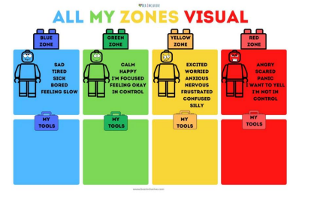
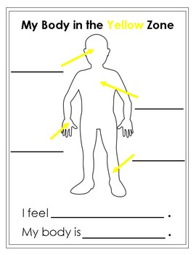

Slide 13
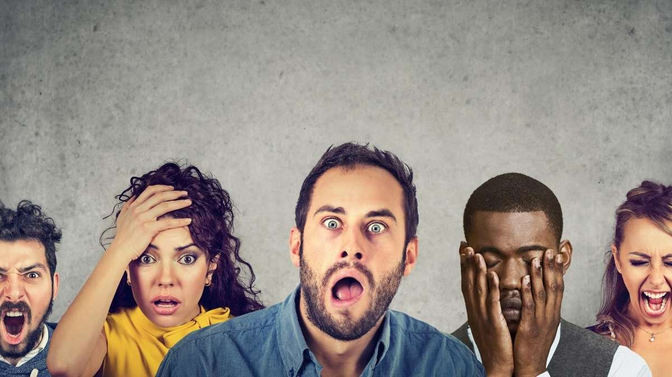
The journey starts with ourselves
(lets take the big feelings out of behaviour management)

Slide 14
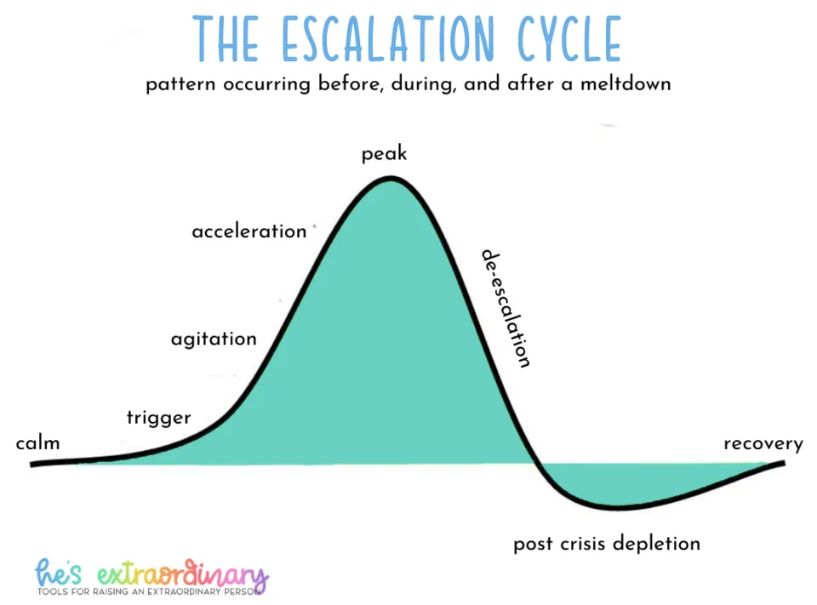

Slide 15
I can see that you are (behaviour), I wonder if your in the _____ zone?
I’d like to help. What helps us get back to green so we can fix it together?
I can see that your in the red zone because you -------. I understand – I’d be in the red zone if that happened to me too.
We don’t _______. When you are green we can find a way to fix this.
You can do ----- or --------.

Slide 16
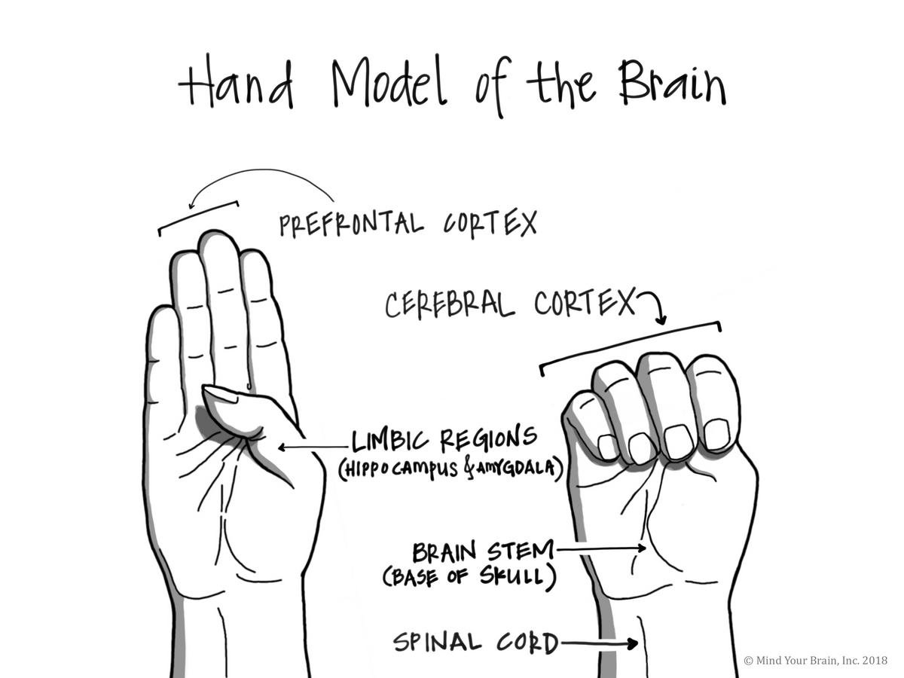
We can think about the brain as have the shape of a closed fist.
The Thumb inside is the Amygdala. This is an ancient part of the brain. It helped ancient humans to stay safe when we lived in the jungle. It helped us to catch our dinners and run away from predators like tigers!
The fingers that wrap around the amygdala are like the part of the brain called the Prefrontal Cortex. This is the part that humans have developed over millions of years. It helps us to think logically - to speak, dream, sing, dance, write and do maths! All the things I’m really good at!

Slide 17
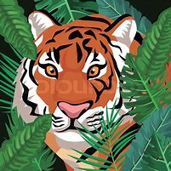
If we get into the red zone - our body thinks we are in danger! Our brain stops using the prefrontal cortex and we ‘flip our lid’. This means that the Amygdala steps in - it wants to keep us and those we love safe!
The problem is - we don't live in the jungle anymore! So the things we do when we are in the red zone don't match where we really are.
This can mean that people get hurt - when really our brain was just trying to keep everyone safe!
So what can we do?
At school we are learning how to ‘get back to green’. When we are in green, our whole brain is working really well together and we can make great choices!
We are learning how to notice when we are in the yellow zone and how to prevent getting out of control and ‘flipping our lid’.
Everybody needs to practice this - even adults!
We will all get red-zone sometimes - and we will all sometimes make mistakes. That is ok!
I have lots of adults around me that I can talk to about my zones.
I can make a list of things that help me feel green.

Slide 18
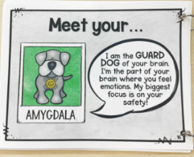
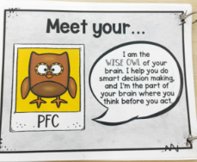

Slide 19


